Slide 1

SMART GAS LEVEL MONITORING,BOOKING AND GAS LEAKAGE DETECTOR OVER IOT
Under the guidance of :
By,
MR.J.KALIDASS M.E.,
Associate Professor/IT,
GOVERNMENT COLLEGE OF TECHNOLOGY
A.NANCY | (1418127)
S.NISHA | (1418132)
P.SIVASANKARI | (1418144)
L.NAGALAKSHMI | (1418L05)

Slide 2
OBJECTIVE
To monitor the gas quantity in the container, and to intimate as well as to place an refill order in the respective branch office(Gas agency), via an message by means of internet through IoT module.

Slide 3
requirements
HARDWARE:
Microcontroller(AT89s52),
Sensors,
Load Cell.
PLATFORM:
ESP- Espressif Systems Smart Platform.

Slide 4
Existing system
ARM PROCESSOR:
This design system detects the leakage of the LPG and alerts the consumer about the leak by SMS and as an emergency measure the system will turn off the power supply.

Slide 5
Continue..
GSM TECHNIQUE:
This system is that it continuously monitors the level of the LPG present in the cylinder using weight sensor and automatically books the cylinder using GSM module.

Slide 6
DISADVANTAGE
There is a use of processor instead of controller.
Lack of awareness for uneducated people.
Hardware complexity.

Slide 7
Proposed system
INTERNET OF THINGS
ESP8266EX offers a complete and self contained WiFi network resolution, it can be used to host the application or to off load wireless networking functions from another applications to the processor.
IoT is the main component which play the major role for updating of the status of the entire kit.

Slide 8
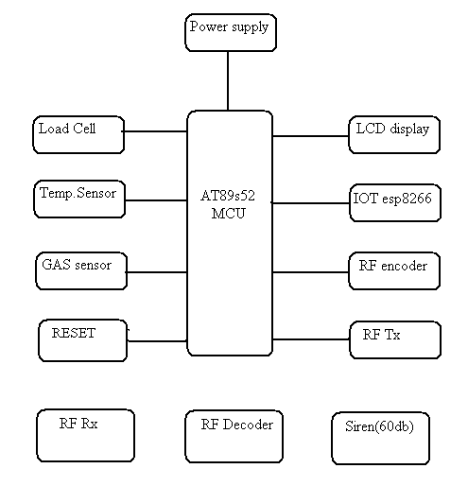
Block diagram

Slide 9
literature review
1.International Journal of Advanced Research in Computer and Communication Engineering, IJARCCE,4(1),January 2015.
2.P Rajasekar S Shyamaladevi, V G Rajaramya and P Sebastin Ashok. Arm7 based automated high performance system for lpg refillbooking & leakage detection. International journal of engineering research, science and technology (IJERST), 3(2), May, 2014.

Slide 10
THANK YOU!!!!

